Slide 1
CP2404/CP5633 Database Modelling
Lecture 05

Slide 2
Lecture 5
Advanced Data Modelling
Reading: Coronel’s Chapter 5
Notes:
2

Slide 3
Learning Objectives
In this lecture, you will learn:
About the extended entity relationship (EER) model’s main constructs and understand the supertype-subtype relationship depicting the specialization hierarchy.
The characteristics of good primary keys and how to select them
How to use flexible solutions for special data modelling cases
What issues to check for when developing data models based on EER diagrams
Notes:
3

Slide 4
Advanced Data Modelling – 1:
Implementing Specialization hierarchy
Notes:
4

Slide 5
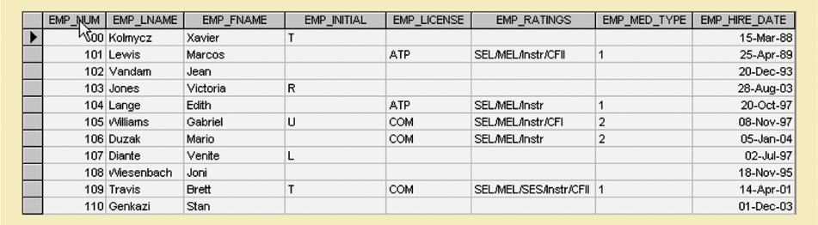
Entity Supertypes and Subtypes
What problem do you see in this table?
Why do we need supertype & subtypes?
5
Notes:
5

Slide 6
Entity Supertypes & Subtypes
The supertype contains the shared (common) attributes related to one or more subtypes
The subtype contains the unique attributes
Which attributes below will be included in supertype or subtype?
6

Slide 7
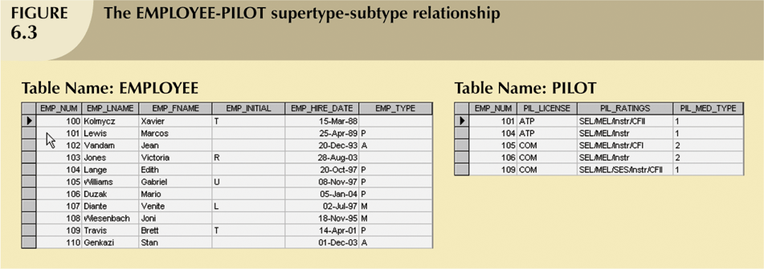
Original table
Supertype - Employee
Subtype - Pilot
7

Slide 8
Entity Supertypes & Subtypes
A subtype entity inherits the properties of the supertype entity (attributes and relationships) from the supertype entity
The Specialization hierarchy depicts the parent-child relationship
Relationships are described in terms of “is-a” relatioships
Every subtype has one supertype to which it is directly related
Supertype can have many subtypes
8

Slide 9
How can we present the specialization hierarch (a supertype and its subtypes) in an ERD?
→ EER Model:
Extended Entity Relationship Model
Adding more semantic constructs to original entity relationship (ER) model
Diagram using this model is called an EER diagram (EERD)‏
9
Notes:
9

Slide 10
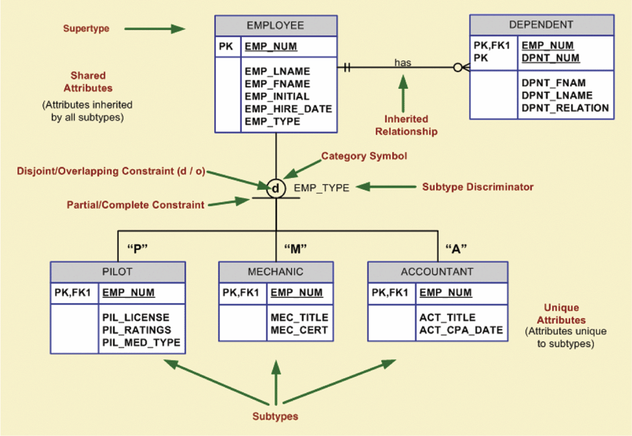
Specialization Hierarchy
10

Slide 11
More about Inheritance
All entity subtype subtypes inherit attributes and relationships of the supertype
All entity subtypes inherit their primary key attribute from their supertype
At the implementation level, supertype and its subtype(s) maintain a 1:1 relationship
Subtypes inherit all relationships in which supertype participates
Lower-level subtypes inherit all attributes and relationships from its all upper-level supertypes
11

Slide 12
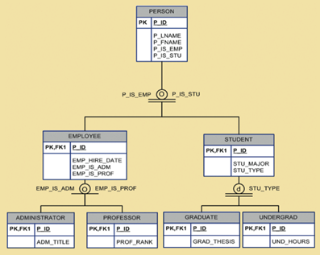
Disjoint and Overlapping Constraints
Disjoint subtypes
Also known as non-overlapping subtypes
Subtypes that contain unique subset of supertype entity set
Overlapping subtypes
Subtypes that contain nonunique subsets of supertype entity set
12
Notes:
12

Slide 13


Completeness Constraints
Partial completeness
Not every supertype occurence is a member of a subtype
Total completeness
Every supertype occurrence must be a member of any
13
Notes:
13

Slide 14
Advanced Data Modelling – 2:
Consideration on Primary Key
Notes:
14

Slide 15
Natural Keys and Primary Keys
Natural key or natural identifier is a real-world, generally accepted identifier used to uniquely identify real-world objects
Data modeller generally uses natural identifier as primary key of entity being modelled
15
Notes:
15

Slide 16
Primary Key Guidelines
Attribute or combination of attributes that uniquely identifies entity instances in an entity set
Main function is to uniquely identify an entity instance or row within a table
To guarantee entity integrity, not to “describe” the entity
16
Notes:
16

Slide 17
Primary Key Guidelines (continued)‏
Non intelligent
No change over time
Preferably single-attribute
Preferably numeric
Security-compliant
17
Notes:
17

Slide 18
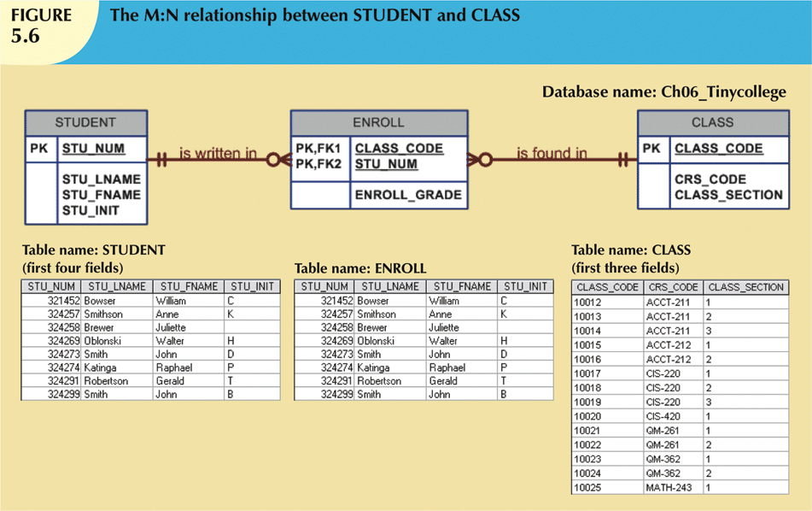
When to Use Composite Primary Keys
Useful for composite entities :
each primary key combination is allowed only once in M:N relationship
Automatically provides benefit of ensuring that there cannot be duplicate values
18
Notes:
18

Slide 19
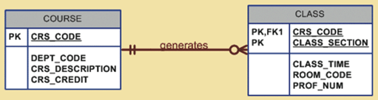
When to Use Composite Primary Keys
Useful for weak entities:
weak entity has strong identifying relationship with parent entity
Normally used to represent:
A real-world object that is existent dependent on another real-world object
A real-world object that is represented in data model as two separate entities in strong identifying relationship
19
Notes:
19

Slide 20
Surrogate Keys (instead of composite PKs)
Primary key used to simplify the identification of entity instances
Especially helpful when there is:
No natural key
Selected candidate key has embedded semantic contents
Selected candidate key is too long or cumbersome
If you use surrogate key, ensure that candidate key of entity in question performs properly through use of “unique index” and “not null” constraints
20
Notes:
20

Slide 21
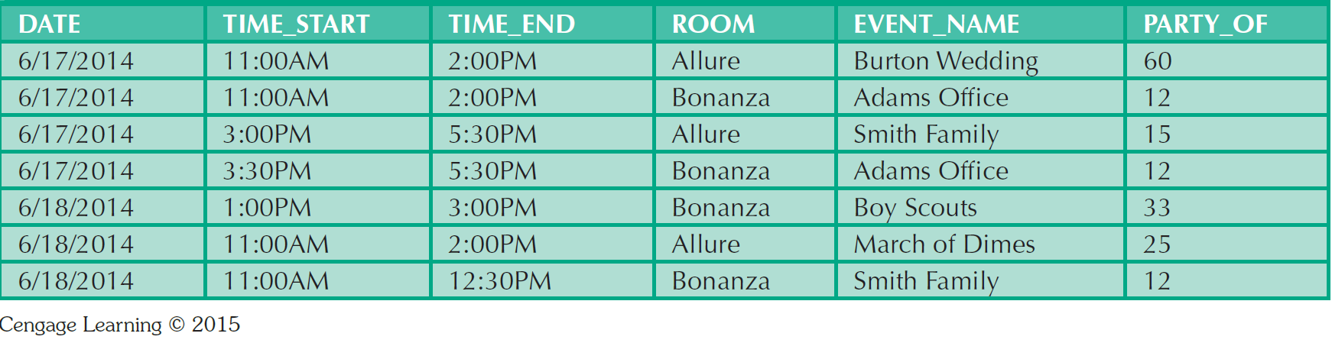
When To Use Surrogate Primary Keys
(instead of using composite PKs)
Event_ID
1
2
3
4
5
6
7
21
Notes:
21

Slide 22
Advanced Data Modelling – 3:
Modelling for Special Design Cases
1:1 Relationships
Maintaining historical data
Fan Traps
Redundant Relationship
Notes:
22

Slide 23
Design Case #1: Implementing 1:1 Relationships
Foreign keys work with primary keys to properly implement relationships in relational model
In 1:M relationships, put primary key of the “one” side (parent entity) on the “many” side (dependent entity) as foreign key
A 1:1 relationship is used to ensure that two entity sets are not placed in same table
23
Notes:
23

Slide 24
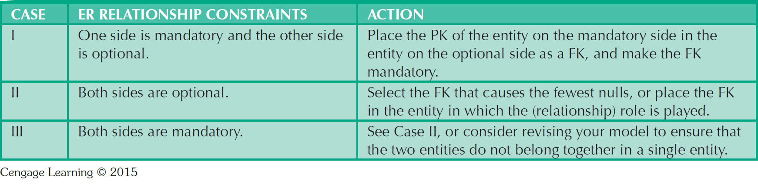
Design Case #1:
Implementing 1:1 Relationships
Which primary key should be used as a foreign key?
24
Notes:
24

Slide 25



Design Case #1:
Implementing 1:1 Relationships‏
25
Notes:
25

Slide 26
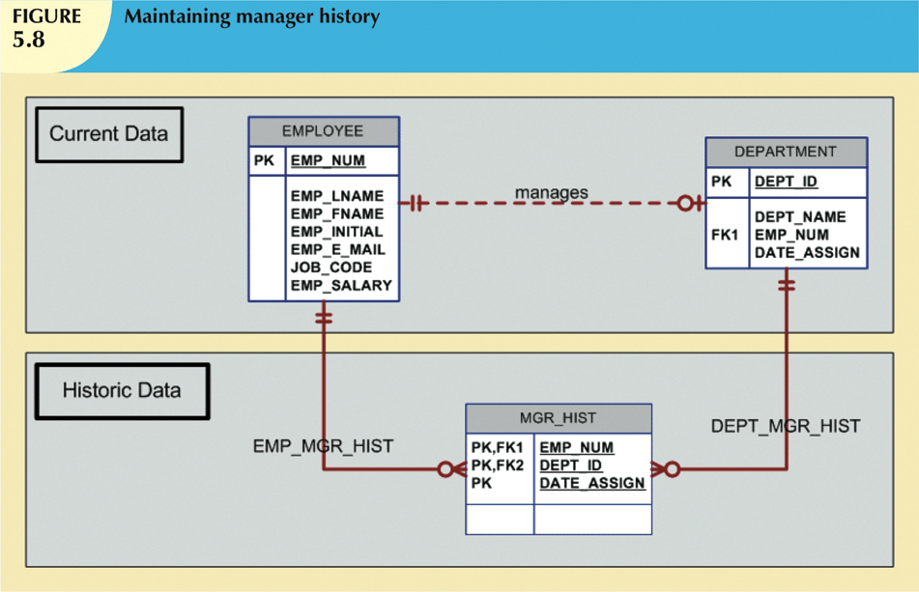
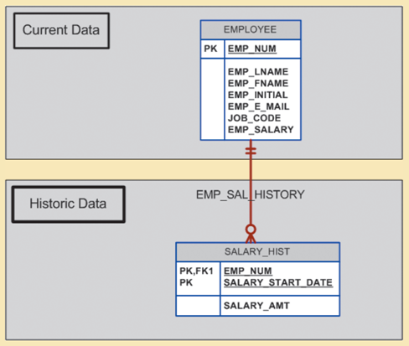
Design Case #2:
Maintaining History of Time-Variant Data
Time-variant data refers to data whose values change over time and for which you must keep a history of data changes
26
Notes:
26

Slide 27
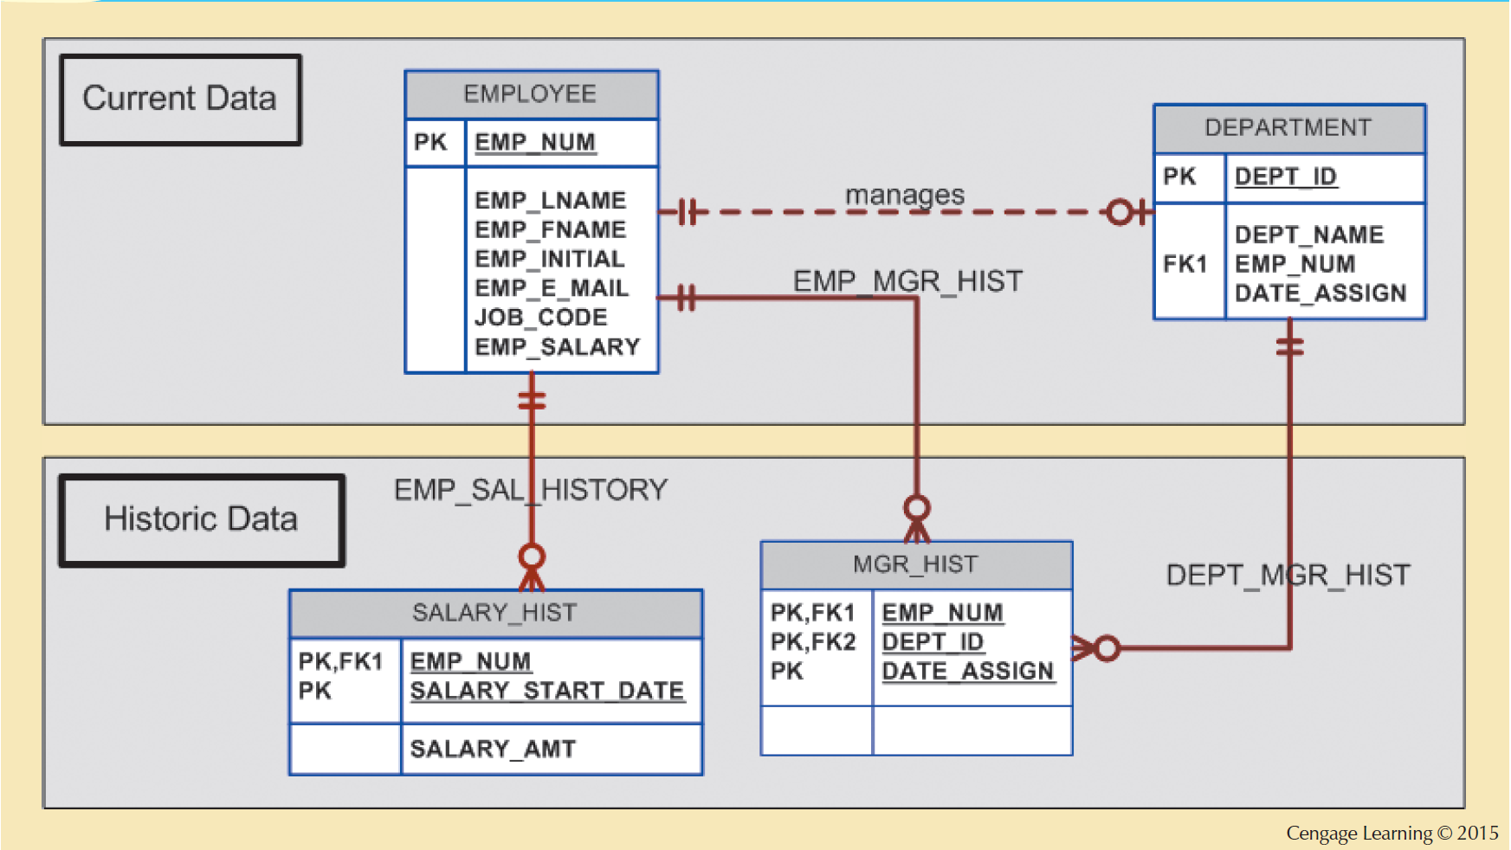
Design Case #2:
Maintaining History of Time-Variant Data
27
Notes:
27

Slide 28
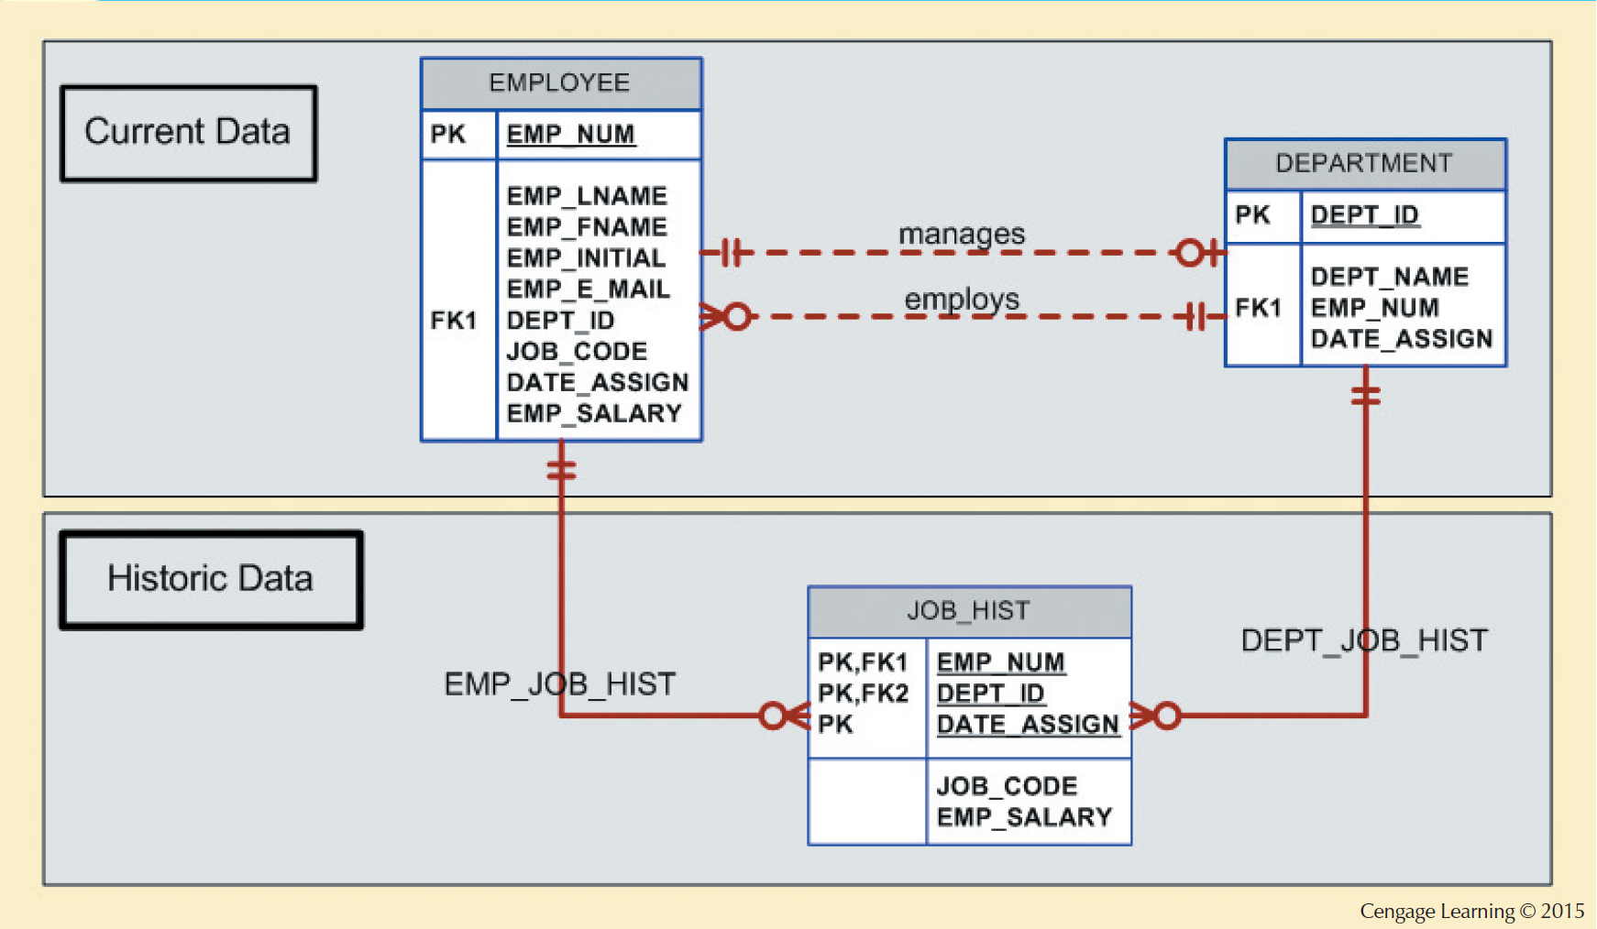
Design Case #2:
Maintaining History of Time-Variant Data
28
Notes:
28

Slide 29
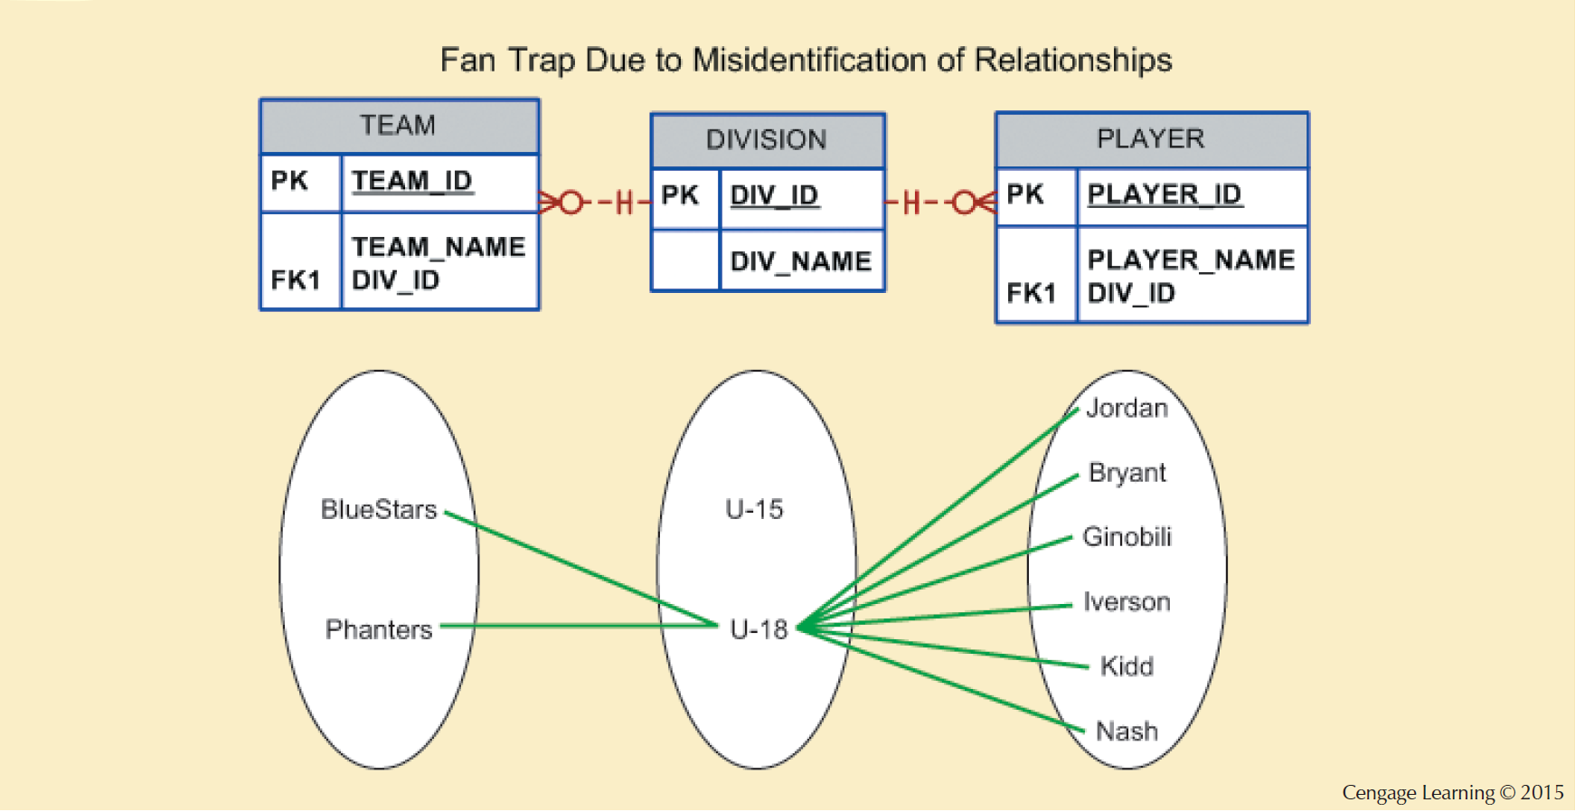
Design Case #3: Fan Traps
Design trap occurs when relationship is improperly or incompletely identified
Most common design trap is known as “Fan trap”
Fan trap occurs when having one entity in two 1:M relationships to other entities
→ The model does not correctly express an association among other entities
29
Notes:
29

Slide 30
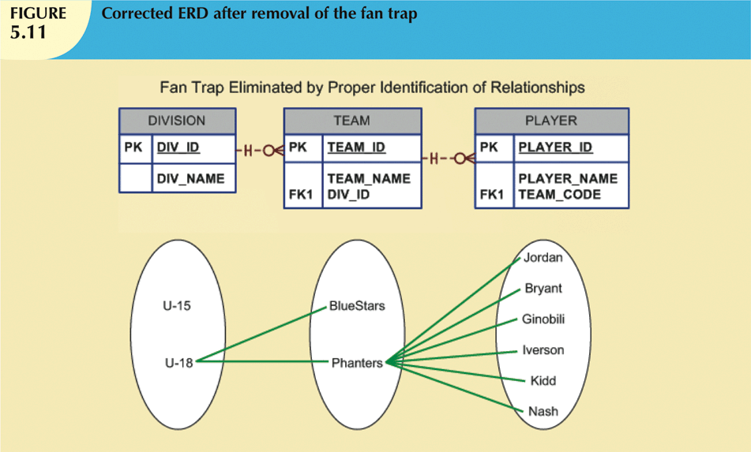
Design Case #3: Fan Traps
30
Notes:
30

Slide 31
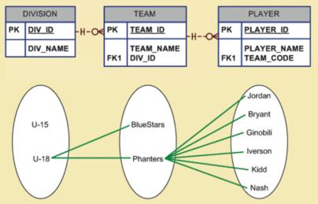
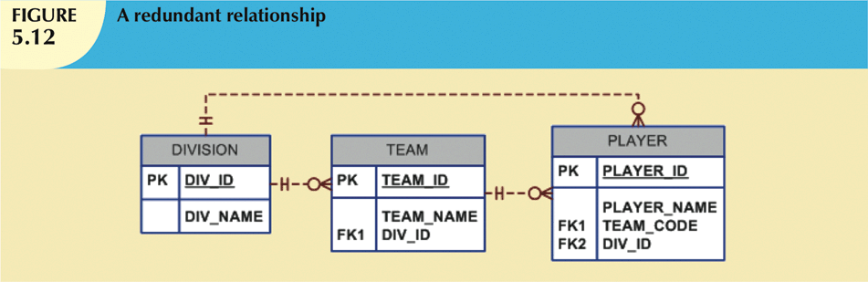
Design Case #4: Redundant Relationships
Redundancy is seldom a good thing in database environment
Occur when there are multiple relationship paths between related entities
Main concern is that redundant relationships remain consistent across model
31
Notes:
31

Slide 32
Final Check-up for your Database Model
Notes:
32

Slide 33
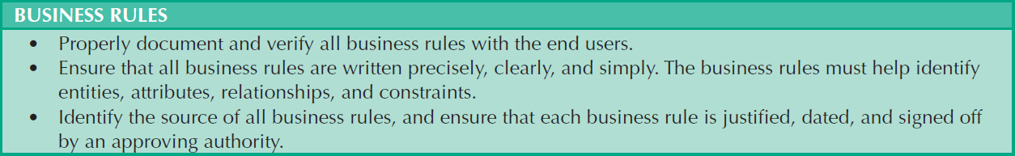
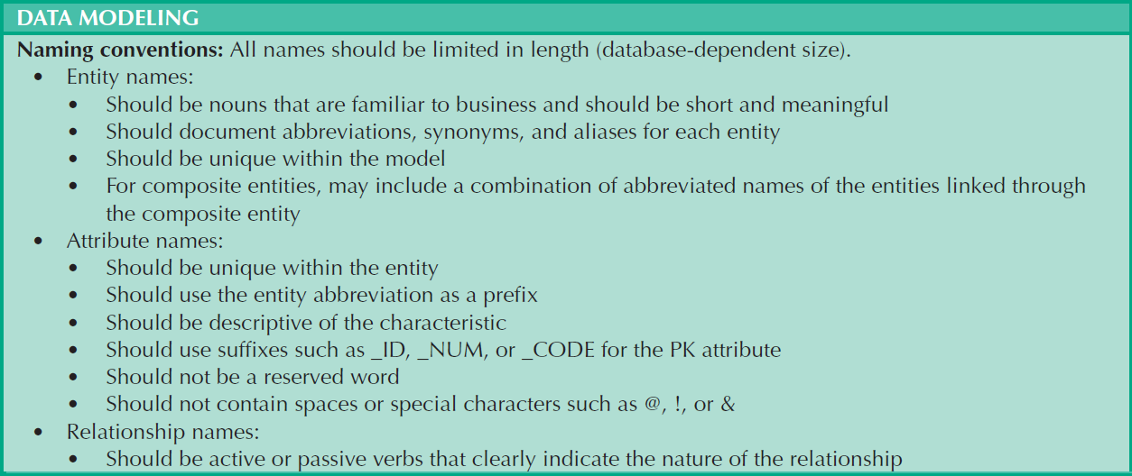
Data Modelling Checklist
33
Notes:
33

Slide 34
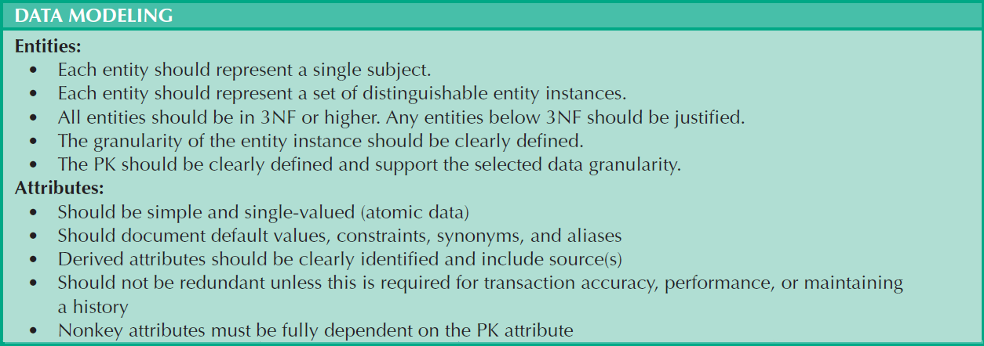
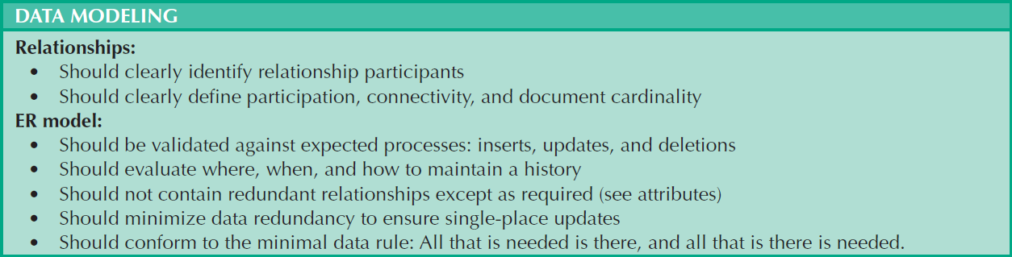
Data Modelling Checklist
34
Notes:
34

Slide 35
Summary
Extended entity relationship (EER) model adds semantics to ER model via entity supertypes and subtypes
Natural keys are identifiers that exist in real world
Composite keys are useful to represent M:N relationships and weak (strong-identifying) entities
Surrogate primary keys are useful when there is no natural key that makes a suitable primary key
In a 1:1 relationship, place the PK of mandatory entity as foreign key in optional entity
Time-variant data refers to data whose values change over time and whose requirements mandate that you keep a history of data changes
35
Notes:
35

